Slide 1
An Intro to Scrum Development
by
Richie Davidson, Parker Kemp,
Kathleen Sebree & Colin Page

Slide 2
The Agile Method
Principles of Agile Methodology
Iterative
Short development cycles that end with customer validation
Incremental
Software is delivered in incremental releases
Notes:
Iterative:A methodology that works with multiple short cycles of progress where at the end of the cycle customer validation is needed
Incremental: A methodology that provides for customer delivery in short increments — that is, shorter release cycles

Slide 3
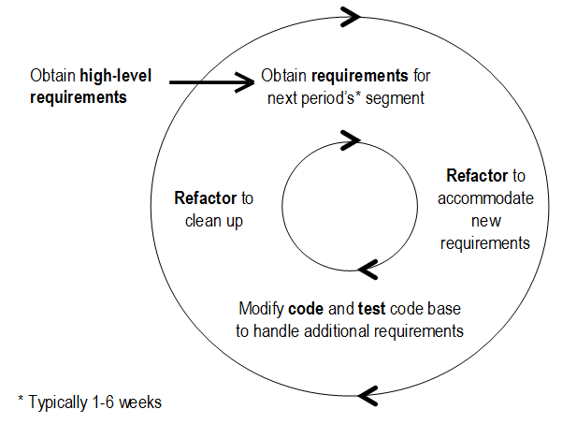
Agile Development Cycle

Slide 4
Agile Implementations
Extreme Programming
Crystal
Kanban
DSDM
Scrum

Slide 5
Scrum
Term Comes from Rugby
Scrum: a play in which the forwards of each side come together in a tight formation and struggle to gain possession of the ball using their feet when it is tossed in among them.
Method of restarting game play after an infraction interrupts play.
Notes:
Developed by Ken Schwaber and Jeff Sutherland in the 1990s.

Slide 6
Scrum
The most common strategy for implementing agile principles
Emphasis on customer involvement
focuses on satisfying the customer through early and continuous delivery of software.

Slide 7
Roles in Scrum
Scrum Master
Oversees daily meetings
Ensures Scrum process is adhered to
Not a traditional team leader or manager
Development Team
Self-organized
Cross-functional skills
Product Owner (Client)
Regularly sees and approves results
Can change requirements at each sprint
Notes:
A short huddle where each member reports on their progress and any issues they may have encountered.
A “Scrum Master”, helps resolve issues encountered to keep things moving smoothly.

Slide 8
Daily Meetings
What has been completed
What issues need resolved
What can we complete before the next meeting
Notes:
A short huddle where each member reports on their progress and any issues they may have encountered.
Only these three questions can be asked during this quick stand up meeting
A “Scrum Master”, often a manager, helps resolve issues encountered to keep things moving smoothly.

Slide 9
Daily Meetings
Held to rigorous schedule
All information is prepared before meeting
Time is set beforehand (‘timeboxed’)
Same location every day
Only core roles speak
Others may attend
Not detailed
Problems identified, not solved
Teams do not require managerial instruction
Notes:
Each team member is prepared ahead of time with their accomplishments and issues.
Meeting is timeboxed, start and end times are set and take effect whether or not all team members are prepared/present

Slide 10
Agile Development Cycle
Sprints
A 1 - 4 week cycle where developers commit to completing a set of features from a backlog of requirements for the software (decided on by the customer).
After each sprint, the software is reviewed by the customer and changes or new requirements can be introduced.
Notes:
At the beginning of each sprint, developers decide what new goals need to be met during the cycle.
At the end of each sprint, the software is reviewed and demonstrated to the customer.

Slide 11
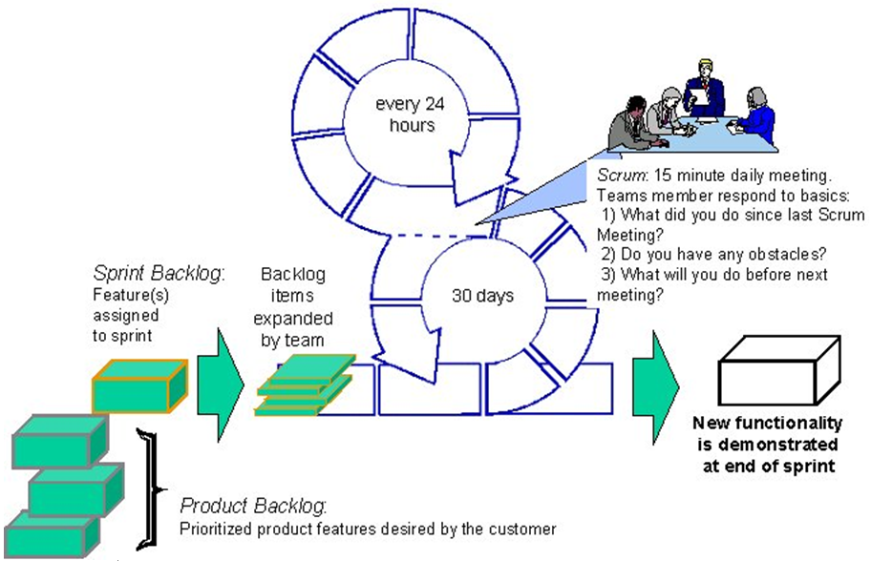
Scrum Development Cycle

Slide 12
Advantages
Flexible - Lets requirements be redefined during development
Productivity is easily measured and managed
A product can potentially be shipped at the end of each iteration
A safe method of development - ensure delivery of product

Slide 13
Advantages
Demonstrates to the customer what has been completed after each sprint
Sprints gives developers a sense of accomplishment
Ensures features are correctly implemented
Ensures that significant progress is made throughout the development process

Slide 14
Disadvantages
Doesn’t work well when developers are not located in the same place
Doesn’t work well with a strict hierarchy of authority - teams must be as autonomous as possible
Requires extra communication if the project is subdivided into separate sprint teams.

Slide 15
Disadvantages
Doesn’t work well with inexperienced developers - Works best with seasoned developers that can work autonomously.
Documentation is secondary to working code and is often neglected.

Slide 16
Questions

Slide 17
References
Software Engineering: A Modern Approach - 2nd Ed.
Agile for Dummies, CA Technologies Ed.
Jeff Sutherland’s Scrum Handbook
http://www.versionone.com/Agile101/Agile-Development-Methodologies-Scrum-Kanban-Lean-XP/

